Slide 1
Applied machine learning (ITC 3003)
Anastasoviti Maria-Christina
Botsiala Theodora
Gazepidis Frixos
Kariotis Alkiviadis 05 April 2023

Slide 2
AGENDA
Introduction
Clustering problem
Regression problem
Classification
Summary/Conclusions

Slide 3
INTRODUCTION
The aim of this project is to apply machine learning techniques in three different datasets, evaluate the results and propose the best technique to be used according the results

Slide 4
Clustering problem
Wholesale customers Data Set

Slide 5
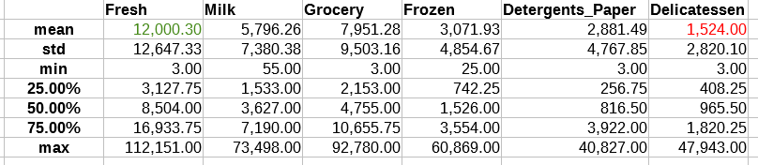
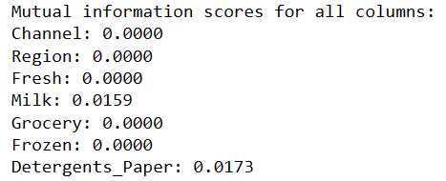
Data set description and data preprocessing
Number of inputs: 440
Number of features: 8 → 6 numerical, 2 categorical
(fresh, milk, grocery, frozen, detergents_paper, delicatessen, channel, region)
Table 1. Basic statistics on numerical data
No missing values
Data standardization: StandardScaler ()
“Region” → target column
Feature selection: mutual_info_classif (X,y)
Split of data into training and test set: train_test_split(X, y, test_size=0.2, random_state=42)

Slide 6
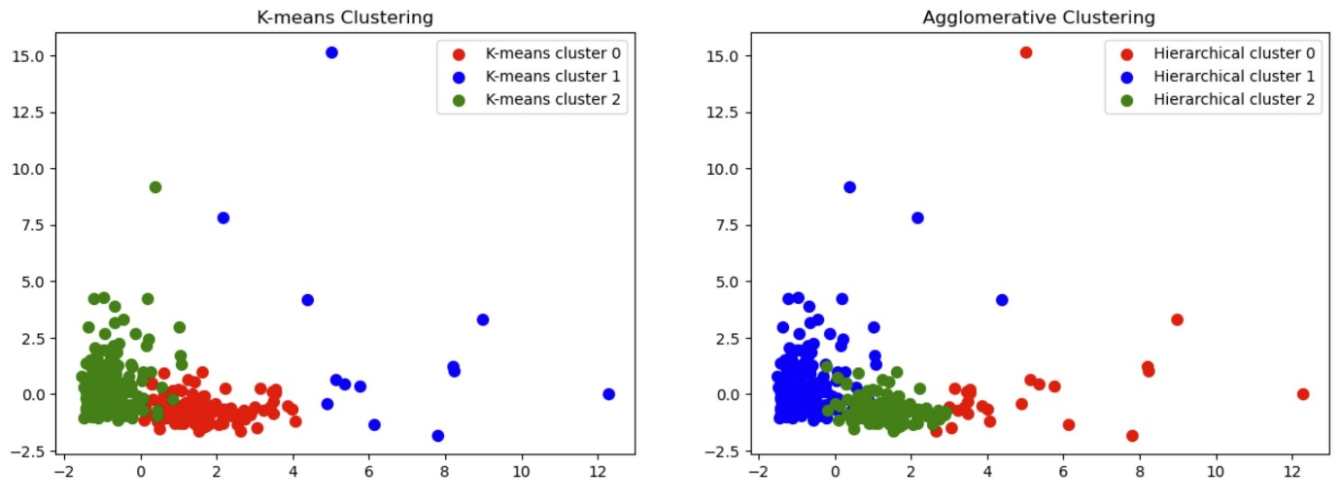
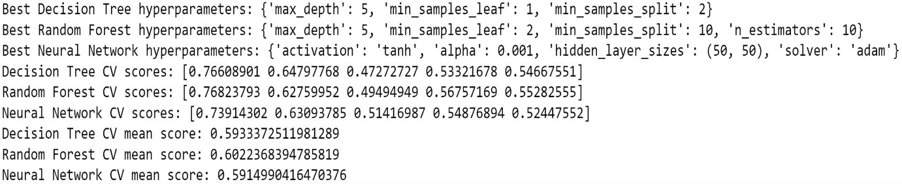
Algorithm description
Classification methods | Metrics
 | F1 score | Precision | Recall
Decision Tree | 0.6611184778586406 | 0.7281468531468532 | 0.6136363636363636
Random Forest | 0.756818181818182 | 0.704016913319239 | 0.8181818181818182
Neural Network | 0.756818181818182 | 0.704016913319239 | 0.8181818181818182
Optimal number of clusters and evaluation of performance
for 2 clusters:
for 3 clusters:
Classification Performance evaluation
Hyperparameter Tuning and Cross-Validation
Characterization of clusters

Slide 7
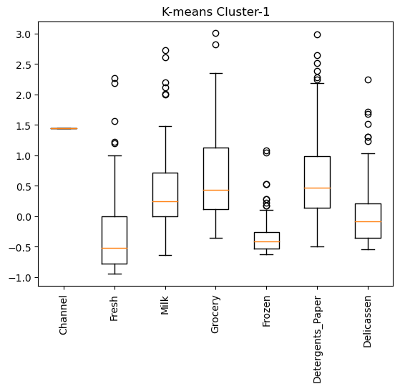
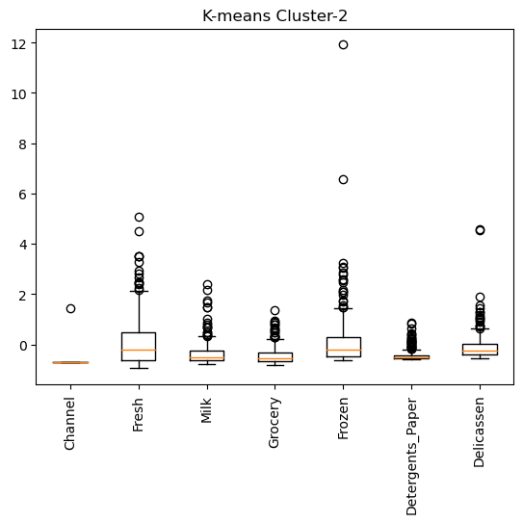
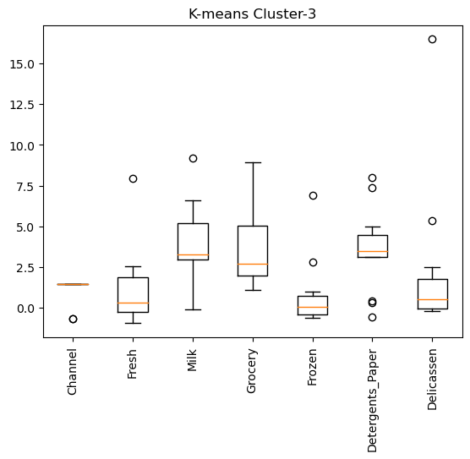
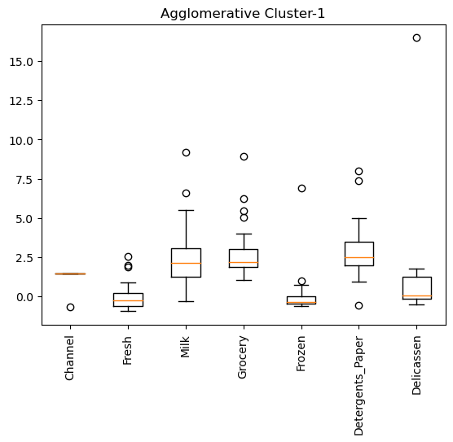
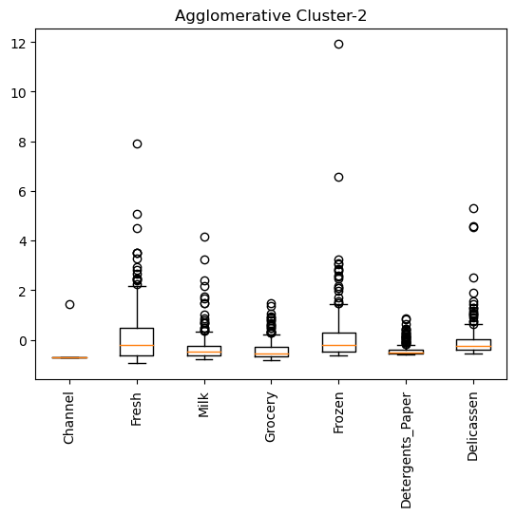
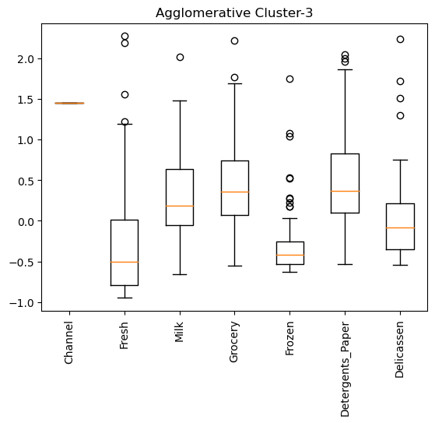
Clustering characterization
 | K-means |  |  | Agglomerative Clustering
 | median | 50% of data | max value | median | 50% of data | max value
Milk | 0.25 | 0.1-0.75 | 1.5 | 2.5 | 2-3.1 | 5.5
Detergent_paper | 0.5 | 0.2-0.9 | 2.25 | 3 | 2-4.1 | 5.1
Milk | 2.7 | 2.5-5 | 6.2 | 0.25 | 0.1-0.75 | 1.5
Detergent_paper | 4 | 3.5-4.9 | 5.1 | 0.5 | 0.2-0.9 | 1.9

Slide 8
Conclusions
Best classification technique: Random Forest
Best parameters for Random Forest: max_depth: 5, min_samples_leaf: 2, min_samples_split 10, n_estimators:10
K-means and Agglomerative Clustering for three clusters: can be used both
More informative features: Milk and the Detergents_paper columns
Both clustering methods indicate that the second cluster consists of outliers
Proposals for improvement
2 clusters for clustering, according to the silhouette score
Further investigation of the characteristics of each cluster in order to exclude some features and perform the analysis on the most informative features (ex. By using PCA)
Classification in each cluster separately for further insights

Slide 9
Regression problem
California House pricing data set

Slide 10
Data set description and data preprocessing
Column | Description
longitude | A measure of how far west a house is; a higher value is farther west.
latitude | A measure of how far north a house is; a higher value is farther north.
housingMedianAge | Median age of a house within a block; a lower number is a newer building.
totalRooms | Total number of rooms within a block.
totalBedrooms | Total number of bedrooms within a block.
population | Total number of people residing within a block.
households | Total number of households, a group of people residing within a home unit, for a block.
medianIncome | Median income for households within a block of houses (measured in tens of thousands of US Dollars)
medianHouseValue | Median house value for households within a block (measured in US Dollars)
oceanProximity | Location of the house w.r.t ocean/sea.
1. Keep only the columns that contain numerical values
2. Remove rows and columns that would lead to df being singular
3. Keep only the columns that have more than one unique values
4. Reduce the number of columns for matrix inversion of kernel density plots
5. The ocean_proximity column includes categorical data. In order to process the information included in this column, one hot encoding is used
6. Inspect if there are any missing values and replace the missing values with the median of the column
7. Define the target column (median_house_value) and remove it from the dataframe
8. Split the data into train and test sets (test_size=0.3)

Slide 11
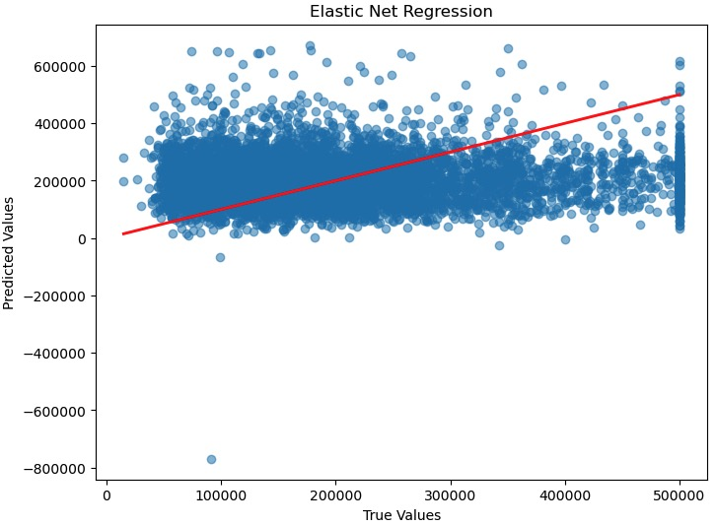
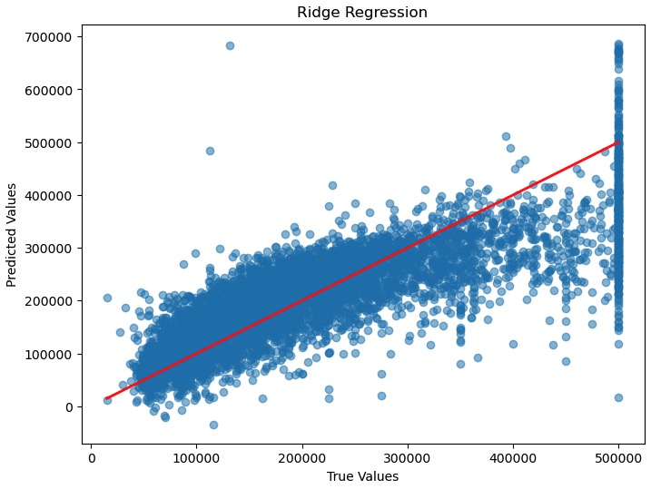
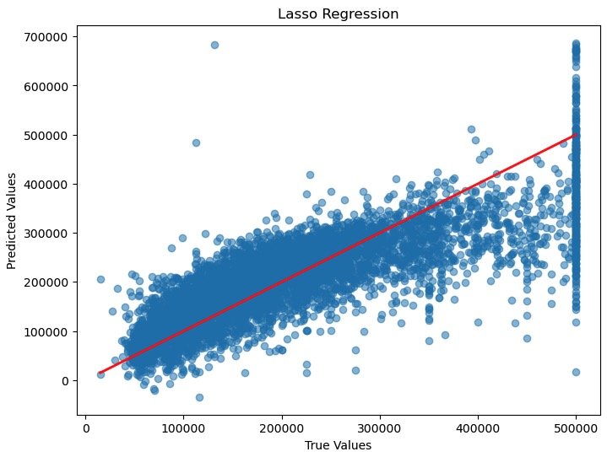

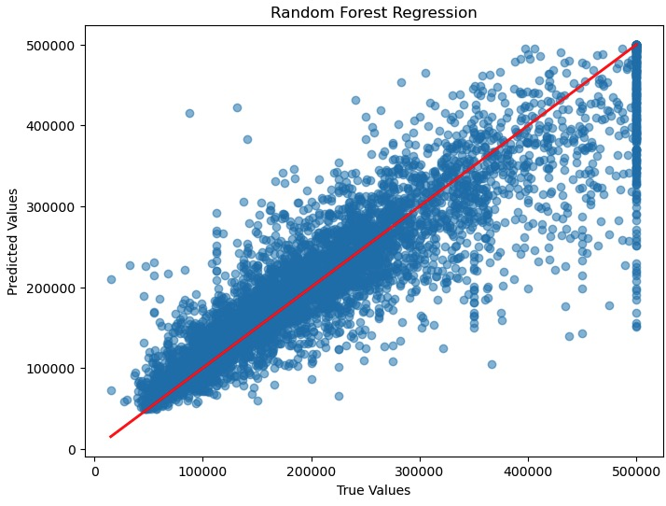

Algorithm description and results
Methods used:
Linear Regression
Random Forest Regression
Ridge Regression
Lasso Regression
Polynomial Regression 2nd degree
Polynomial Regression 3rd degree
Evaluation:
R² score
MSE
 | R² score | MSE
Linear Regression | 0.63214 | 4915946303.11553
Ridge Regression | 0.63217 | 4915479673.72290
Lasso Regression | 0.63214 | 4915884402.40221
Random Forest Regression | 0.81092 | 2526744428.43395
Polynomial Regression (Degree 1- performed Grid Search for best degree) | 0.63214 | 104447803085970000.00
Elastic Net Regression | 0.62475 | 4951356798.93628

Slide 12
Conclusions
There is a linear correlation between the features of the data set
A Linear Model could explain approximately 65 % of the variance of the data set
No significant improvement by applying Regularization techniques, such as Lasso and Ridge Regression
Proposals for improvement
Since Linear techniques are sensitive to outliers, a further research could be performed in order to exclude the outliers from the data set and re-perform linear fit

Slide 13
classification problem
Adult data set

Slide 14
Data set description and data preprocessing
14 columns (attributes) and 48842 rows (inputs).
Attributes:
age: continuous numerical
workclass: categorical
fnlwgt: continuous numerical
education: categorical
education-num: continuous numerical
marital-status: categorical
occupation: categorical
relationship: categorical
race: categorical
sex: categorical binary
capital-gain: continuous numerical
capital-loss: continuous numerical
hours-per-week: continuous numerical
native-country: categorical
income: continuous numerical
1. Read and clean the adult.data
2. Read and clean the adult.test
3. Create two new dataframes with the train and the test data, after the cleaning
4. Use one hot encoding for handling of the categorical data
5. Separate the features (X) and the target (y) in both datasets

Slide 15
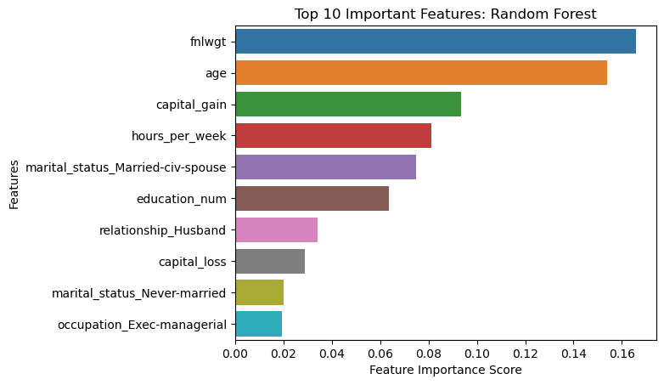
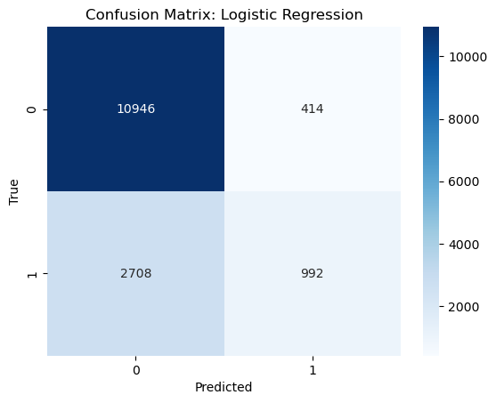
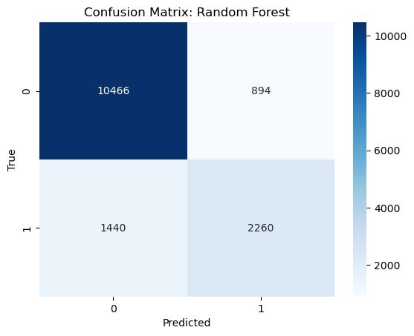
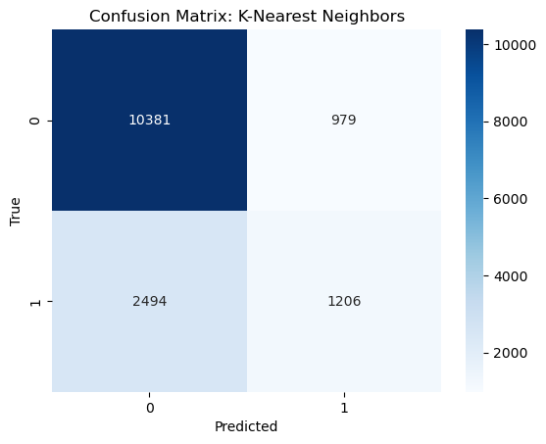
Algorithm description and results
 |  | Logistic Regression | Random Forest | K-Nearest Neighbor
accuracy |  | 0.793 | 0.845 | 0.769
precision | 0 class | 0.8 | 0.88 | 0.81
 | 1 class | 0.71 | 0.72 | 0.55
recall | 0 class | 0.96 | 0.92 | 0.91
 | 1 class | 0.27 | 0.62 | 0.33
f-1 score | 0 class | 0.88 | 0.9 | 0.86
 | 1 class | 0.39 | 0.66 | 0.41
Method used: Logistic Regression, Random Forest, K-Nearest Neighbor
Evaluation: accuracy, precision, recall, f-1 score
Explainable AI approach: SHAP

Slide 16
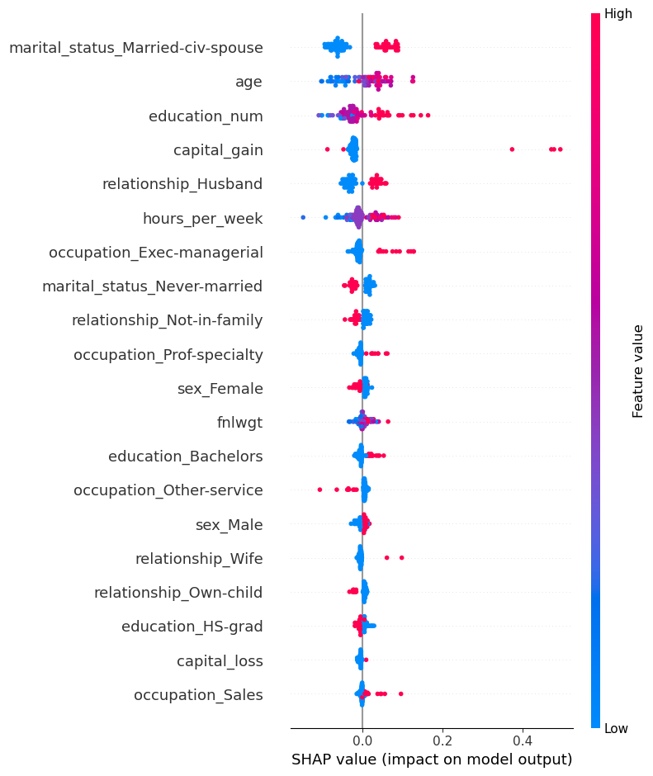
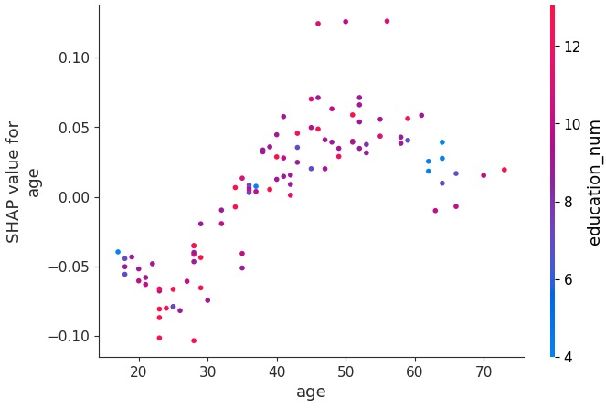
Explainable ai (shap)

Slide 17
SUMMARY/conclusions
The optimal technique to be used for each clustering/regression/classification problem depends on the data set.
The pre-processing and the hyperparameter tunning steps are very important for the overall analysis and have a significant impact on the results.
Several approaches should be investigated in order to obtain the optimal result.
Visual representations are very useful.

Slide 18
THANK YOU

